Slide 1
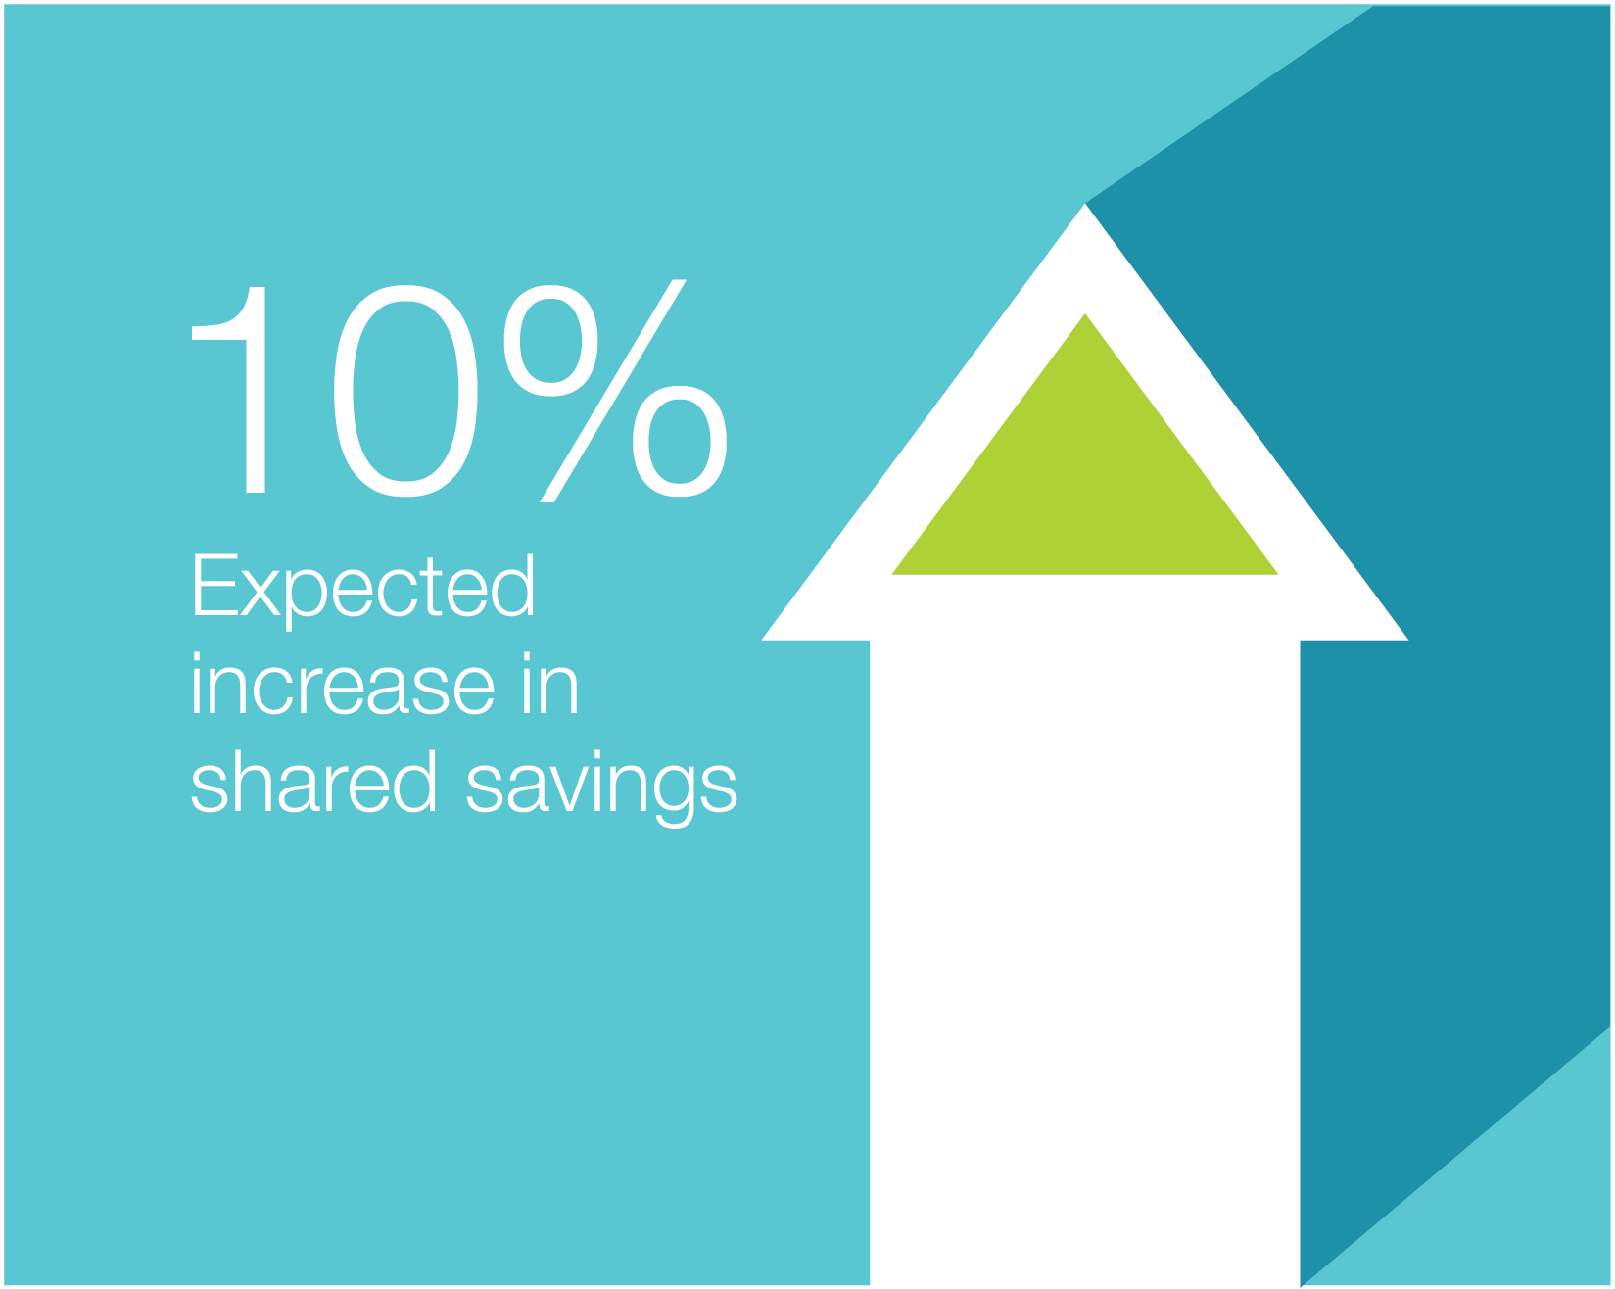
CCM Benefits Your Practice
Premier will do the heavy lifting to help bring a higher-level of care to your chronic patients, and:
Help provided to manage high-risk patients frees time for other patients = more billable encounters for your practice

Slide 2
Physician / Patient Enrollment
Step 1
Physician to provide Premier with all ACO patient Medicare demographics (Name, Phone, Address, DOB, HICN)
Physician to provide Premier with non-ACO patient Medicare data after obtaining patient’s consent (Name, Phone, Address, DOB, HICN)

Slide 3
Physician / Patient Enrollment
Step 2
Premier to train Physician/NP on how to enroll patients into CCM, by scheduling office visits and obtaining patient consent to enroll via ABN and Consent Form
Premier Account Manager to collect Physician’s completed Form 855R, enabling Premier to bill for CCM and reimburse Physician $10 PM/PM

Slide 4
Physician / Patient Enrollment
Step 3
Physician/NP to obtain consent from patients to enroll into CCM Program during their next office visit
CMS requires Physicians to obtain patient consent during an office visit
Physician MUST ensure patient’s consent form is uploaded into 360 or faxed to Premier to initiate process

Slide 5
What does the patient need to do?
1
2
3
READ
READ & SIGN
READ & SIGN
Letter from the Provider to the patient introducing CCM
Official Patient Consent Form to participate in CCM (pre populated)
Advance Beneficiary Notice (ABN) Form- citing $8 co pay

Slide 6
Which patients should I enroll?

